Slide 1
Unit-4
Packages and Java Library
Oops through java

Slide 2
Packages in Java
A package in Java is a namespace that organizes classes and interfaces into a structured manner.
Think of it like a folder in your computer that contains related files.

Slide 3
Why use packages?
Organization – Groups related classes/interfaces together (like java.util, java.sql).
Avoids name conflicts – Two classes with the same name can exist in different packages.
Reusability – Once a package is created, it can be reused across multiple projects.

Slide 4
Types of Packages
Built-in Packages (predefined in JDK)
  Examples:
    java.lang → fundamental classes (String, Math, Object, Exception)
    java.util → collections, date/time, utility classes
    java.io → input/output streams, file handling
    java.sql → database connectivity (JDBC)
    java.net → networking

Slide 5
Types of Packages
User-defined Packages (created by programmers)
Package = way to organize and group classes.
Java Library = collection of predefined packages and classes provided by Java for faster development.

Slide 6
1.2 Defining Package
package keyword is used.
Must be the first statement in a Java file (except comments).

Slide 7
1.3 Importing Packages and Classes into Programs
Three ways:
Single Class Import
import java.util.Scanner;
Import All Classes
import java.util.*;
Fully Qualified Name
java.util.Scanner sc = new java.util.Scanner(System.in);

Slide 8
1.4 Path and Class Path
Definition:
The PATH is an environment variable in your operating system.
It tells the OS where to look for executables like javac (Java compiler) and java (Java interpreter).
· Usage:
Without setting the PATH, you must run Java commands from the bin directory of JDK.
With PATH set, you can run Java commands from anywhere.

Slide 9
1.4 Path and Class Path
ClassPath → Tells JVM where to look for user-defined classes and packages.
Definition:
The CLASSPATH is an environment variable (or command-line option) that tells Java where to look for user-defined classes, packages, and libraries.

Slide 10
1.5 Access Control
Public → accessible everywhere.
Protected → accessible in same package + subclasses.
Default (no modifier) → accessible only within the package.
Private → accessible only inside the class.

Slide 11
1.6 Packages in Java SE
java.lang → Core classes (String, Math, Object).
java.util → Utility classes (ArrayList, Collections, Date, Scanner).
java.io → Input/Output streams.
java.sql → Database connectivity.
java.time → Date & time API.

Slide 12
1.7 java.lang Package and its Classes
Automatically imported in every Java program.
Contains:
  Object
  String
  Math
  Wrapper classes (Integer, Double, etc.)
  Enum

Slide 13
1.8 Class Object
The superclass of all classes in Java.
Methods: toString(), equals(), hashCode(), getClass().

Slide 14
1.9 Enumeration
Special class for defining constants.
enum Direction { NORTH, SOUTH, EAST, WEST }
public class EnumDemo {
public static void main(String[] args) {
Direction d = Direction.NORTH;
System.out.println(d);
}
}

Slide 15
1.10 Class Math
Provides mathematical functions.
Methods: sqrt(), pow(), abs(), max(), min(), random().

Slide 16
1.11 Wrapper Classes
Used to wrap primitive data types into objects.
Example: int → Integer, double → Double.

Slide 17
1.12 Auto-boxing and Auto-unboxing
Autoboxing: automatic conversion of primitive → wrapper.
Unboxing: wrapper → primitive.
Integer i = 10; // autoboxing
int x = i; // unboxing

Slide 18
1.13 Java util Classes and Interfaces
ArrayList, HashMap, Collections, Date, Scanner, etc.

Slide 19
1.14 Formatter Class
Used for formatted output (like printf).
System.out.printf("Value: %.2f", 12.3456);

Slide 20
1.15 Random Class
Used to generate random numbers.
Random r = new Random();
System.out.println(r.nextInt(100)); // 0-99

Slide 21
1.16 Time Package
In Java, the time package is part of the java.time package introduced in Java 8 as a modern replacement for the older java.util.Date and java.util.Calendar.
It provides classes to handle dates, times, durations, periods, and time zones in a more clear, immutable, and thread-safe way.
Introduced in Java 8 (java.time).
Classes: LocalDate, LocalTime, LocalDateTime, Instant.

Slide 22
1.17 Class Instant (java.time.Instant)
The Instant class in Java is part of the java.time package and represents a specific point on the timeline, i.e., a timestamp in UTC (Coordinated Universal Time).
It is immutable and thread-safe, making it better than java.util.Date.
Represents a moment in UTC time.
Instant now = Instant.now();
System.out.println(now);

Slide 23
1.18 Formatting for Date/Time in Java
In Java, formatting date and time means converting date/time objects into a human-readable string or parsing strings into date/time objects. Since Java 8, the java.time package provides a modern API using DateTimeFormatter.
1. Using DateTimeFormatter
DateTimeFormatter is immutable and thread-safe. You can define predefined formats or custom patterns.

Slide 24
1.19 Temporal Adjusters Class
The TemporalAdjusters class in Java (java.time.temporal.TemporalAdjusters) provides a set of static utility methods to perform common date adjustments on objects that implement the Temporal interface (like LocalDate or LocalDateTime).
It’s very useful for getting the first/last day of a month, next Monday, etc. without manual calculations.

Slide 25
2. Exception Handling
2.1 Introduction
Exceptions are errors that occur during runtime.
Exception handling ensures smooth program execution.

Slide 26
2.2 Hierarchy of Standard Exception Classes
Throwable (superclass)
  Error (serious issues, not handled)
  Exception
    Checked Exceptions (must be handled)
    Unchecked Exceptions (runtime errors)

Slide 27
2.3 Keywords throws and throw
throw → used to throw an exception manually.
throws → declares exceptions in method signature.

Slide 28
2.4 try, catch, and finally Blocks
try {
int a = 10 / 0;
} catch (ArithmeticException e) {
System.out.println("Cannot divide by zero");
} finally {
System.out.println("Always executes");
}

Slide 29
2.5 Multiple Catch Clauses
try {
String s = null;
System.out.println(s.length());
} catch (ArithmeticException e) {
System.out.println("Math error");
} catch (NullPointerException e) {
System.out.println("Null error");
}

Slide 30
2.6 Class Throwable
Superclass for all exceptions and errors.
Methods: getMessage(), printStackTrace().

Slide 31
2.7 Unchecked Exceptions
Subclass of RuntimeException.
Example: NullPointerException, ArrayIndexOutOfBoundsException.

Slide 32
2.8 Checked Exceptions
Must be handled using try-catch or throws.
Example: IOException, SQLException.

Slide 33
3. Java I/O and File Handling
3.1 Java I/O API
Provides classes for input/output operations.
Located in java.io package.

Slide 34
3.2 Standard I/O Streams
System.in → standard input.
System.out → standard output.
System.err → standard error.

Slide 35
3.3 Types of Streams
Byte Streams (InputStream, OutputStream)
Character Streams (Reader, Writer)

Slide 36
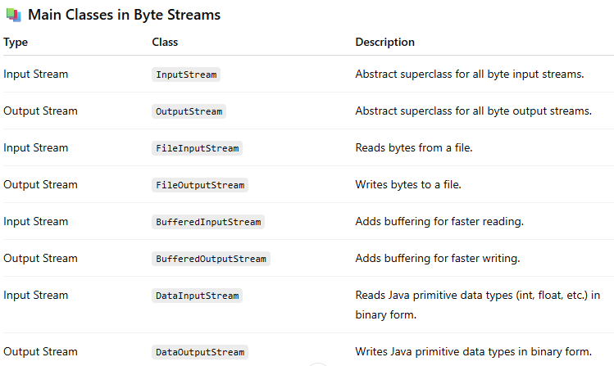
3.4 Bytestreams

Slide 37
3.5 Character Streams
Character Streams in Java are used to perform input and output (I/O) of text data, that is, data made up of characters (letters, digits, symbols, etc.).
Definition
Character streams handle I/O of characters (text data).

Slide 38
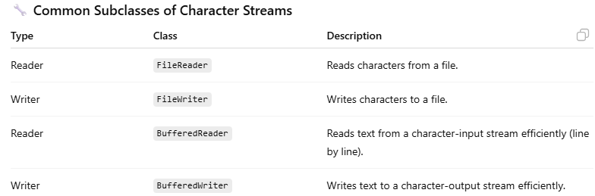
3.5 Character Streams

Slide 39
3.6 Files in Java
Files in Java
In Java, files are used to store and retrieve data permanently from the file system (like hard disk).
Java provides the java.io and java.nio.file packages to handle file operations such as creating, reading, writing, and deleting files.

Slide 40
3.6 Files in Java
What is a File in Java?
A file is a named location on the disk to store data permanently.
Java provides the File class to represent and manipulate files and directories.

Slide 41
3.6 Files in Java
The File Class
Package: java.io
Class: java.io.File
Used to create, delete, and get information about files and directories.

Slide 42
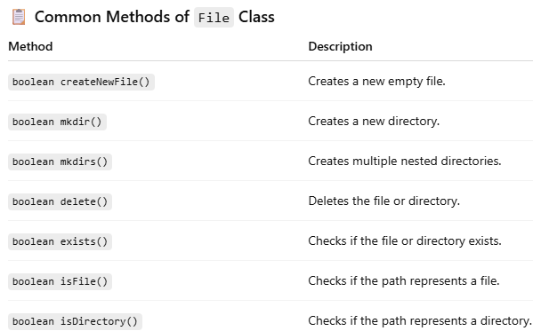
3.6 Files in Java

